Slide 1

CS105.3
Database Management Systems ER Model

Slide 2
Steps…
Idea
ER Diagram
Relational Schema
RDBMS

Slide 3
ERD
ERD is a data modeling methodology used in software engineering to produce a conceptual data model of a database system.

Slide 4
Data Modeling
The data modeling revolves around discovering and analyzing organizational and users data requirements.
The requirements for the model development must be based on policies, stakeholders (e.g., survey, discussion, observation, etc.), business procedures, system specifications, and so on.
Identify what data is important!
Identify what data should be maintained!
Notes:
7

Slide 5

Procedure of ERD
4
3
Data modeling is iterative process.
“complete” and “100% error free” model is not possible!
Only “Optimized” model is possible….
Steps to create an ERD

Slide 6
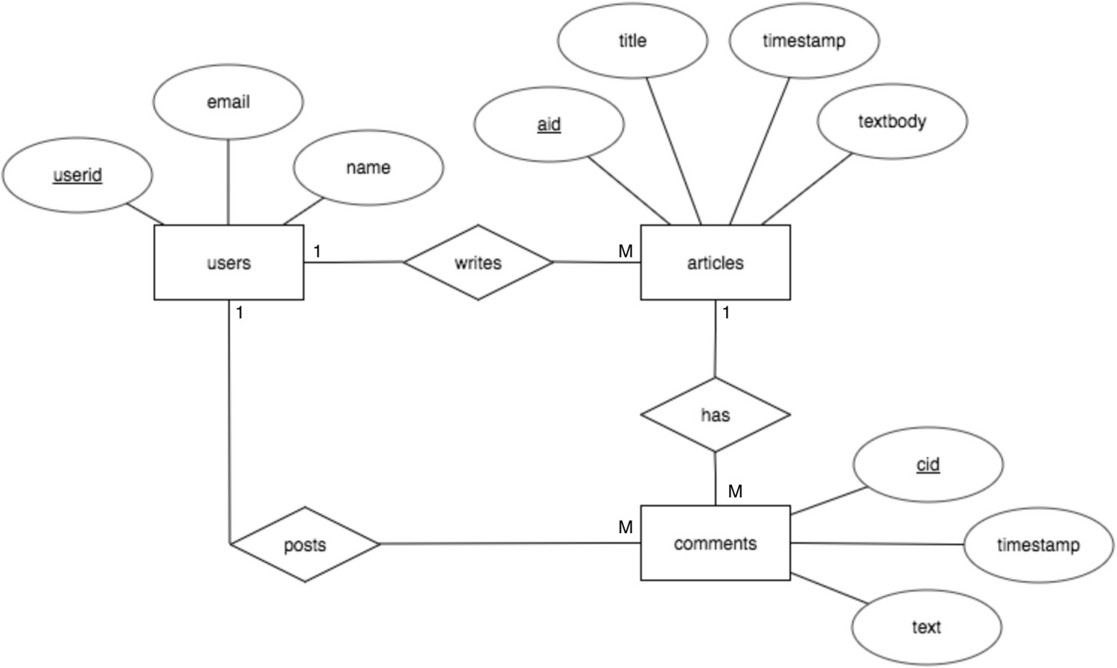
Sample ERD

Slide 7
In a university, a Student enrolls in Courses. A student must be assigned to at least one or more Courses. Each course is taught by a single Professor. To maintain instruction quality, a Professor can deliver only one course.

Slide 8
ERD
4
The major activity of this phase is identifying entities, attributes, and their relationships to construct model using the Entity Relationship Diagram.
Entity → table
Attribute → column
Relationship → line

Slide 9
Symbols
Chen Notation
Notes:
An identifying relationship is when the existence of a row in a child table depends on a row in a parent table.
A Person has one or more phone numbers. If they had just one phone number, we could simply store it in a column of Person. Since we want to support multiple phone numbers, we make a second table PhoneNumbers, whose primary key includes the person_id referencing the Person table.

Slide 10
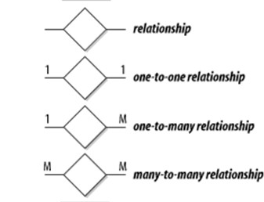
Chen Notation

Slide 11
How to find entities?
6
Entity:
"...anything (people, places, objects, events, etc.) about which we store information (e.g. supplier, machine tool, employee, utility pole, airline seat, etc.).”
Tangible: customer, product
Intangible: order, accounting receivable
Look for singular nouns (beginner)
BUT a proper noun is not a good candidate….

Slide 12
Entity Instance
7
Entity instance: a single occurrence of an entity.
6 instances
Entity: student
Student ID | Last Name | First Name
2144 | Arnold | Betty
3122 | Taylor | John
3843 | Simmons | Lisa
9844 | Macy | Bill
2837 | Leath | Heather
2293 | Wrench | Tim
instance

Slide 13
How to find attributes?
8
Attribute:
Attributes are data objects that either identify or describe entities (property of an entity).
In other words, it is a descriptor whose values are associated with individual entities of a specific entity type
The process for identifying attributes is similar except now you want to look for and extract those names that appear to be descriptive noun phrases.

Slide 14
Classes of attributes
9
Simple attribute
Composite attribute
Derived attributes
Single-valued attribute
Multi-valued attribute

Slide 15
Simple/Composite attribute
1
0
A simple attribute cannot be subdivided.
Examples: Age, Gender, and Marital status
A composite attribute can be further subdivided to yield additional attributes.
Examples:
ADDRESS --→ Street, City, State, Zip
PHONE NUMBER --→ Area code, Exchange number

Slide 16

Derived attribute
1
1
is not physically stored within the database
instead, it is derived by using an algorithm.
Example 1: Late Charge of 2%
MS Access: InvoiceAmt * 0.02
Example 2: AGE can be derived from the date of birth and the current date.
MS Access: int(Date() – Emp_Dob)/365)

Slide 17
Single-valued attribute
1
2
can have only a single (atomic) value.
Examples:
A person can have only one social security number.
A manufactured part can have only one serial number.
A single-valued attribute is not necessarily a simple attribute.
Part No: CA-08-02-189935
Location: CA, Factory#:08, shift#: 02, part#: 189935

Slide 18

Multi-valued attributes
1
3
can have many values.
Examples:
A person may have several college degrees.
A household may have several phones with different numbers
A car color

Slide 19
Exercise - “Movie Database”
1
4
Identify the types of attributes of the Movie Star Entity
Entity:
Movie Star
Attributes:
SSN# : “123-45-6789”
Cell Phone : “(661)123-4567, (661)234-5678”
Name
Address
Gender
: “Harrison Ford”
: “123, Main Str., LA, CA”
: “Female”
Birth date : “02-05-1990”
Age : “24”

Slide 20
Key Attributes
An attribute of an entity type for which each entity must have a unique value is called a key attribute of the entity type.
E.g. SSN of EMPLOYEE.
A key attribute may be composite.
E.g. VehicleTagNumber is a key of the CAR entity type with components (Number, State).
An entity type may have more than one key. For example, the CAR entity type may have two keys:
VehicleIdentificationNumber (popularly called VIN) and
VehicleTagNumber (Number, State), also known as license_plate
number.

Slide 21
Concepts of Keys
Candidate key
Primary key
Super Key
Alternate key/Secondary Keys
Composite key
Foreign key

Slide 22
Candidate key
A candidate key is a minimal set of attributes necessary to identify a tuple.
E.g. employeeID is a candidate key
Each table may have one or more candidate keys. One of these candidate keys is selected as the table primary key.
S ID | SName | Marks
S1 | A | 40
S2 | A | 40
S3 | B | 50
S2 | B | 50

Slide 23
Primary key
One of the candidate keys that has no NULL values.
Null = Unknown
An attribute (or combination of attributes) that uniquely identifies each row in a relation.
–Employee(Emp_No, Emp_Name, Department)

Slide 24
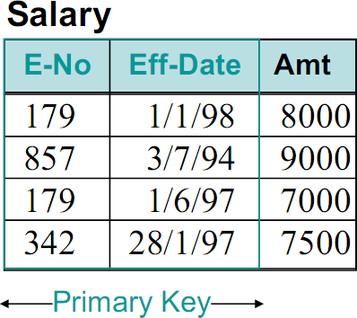
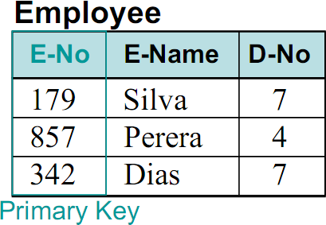
Primary key-Example

Slide 25
Composite Key
A primary key that consists of more than one attribute
–Salary(Emp_No, Eff_Date, Amount)

Slide 26
Alternate key
An alternate key is any candidate key that is not the primary key. Alternate keys are sometimes referred to as secondary keys.
Null values are allowed
More that one alternate keys are allowed
S ID | Bank ACC | Name | Votee ID
1 | Acc1 | A | V1
2 | Acc2 | B | V2
3 | Acc3 | A | V3
4 | Acc4 | B | V4
5 | Acc5 | A | null

Slide 27
Super key
Super key = candidate key + 0 or more attributes
Every candidate key is a super key
Every super key cannot be a candidate key
Minimal super key becomes the candidate key
E ID | Salary | E Name
1 | 400 | A
2 | 500 | B
3 | 400 | A
4 | 500 | C

Slide 28
Foreign Key
An attribute in a relation of a database that serves as the primary key of another relation in the same database
E-No | EmpName | Dep-No
12 | Sarath | 1
34 | Kumara | 2
Dep-No | Locations
1 | Gampaha
2 | Colombo
Primary Key
Foreign Key
Primary Key

Slide 29
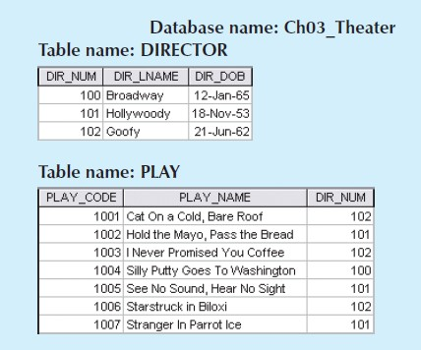
Exercise
Using the above tables
Identify foreign keys
Identify primary keys

Slide 30


